Slide 1
JC Consulting Capstone Project
T21 AND T24

Slide 2
Teams:
T21
Abdallahman - 101087205
Anushka - 101195651
Renata Moura – 101096098
T24
Chris Santin – 101076623
Quan - 101094529
Duy Hao Bui - 101104656
Tam Dang- 101092895

Slide 3
Agenda
About the project
Problems / Solutions
Database
Product Demo
Remaining Work and Next Step

Slide 4
About
Recruitment, professional services, support organization
Serves job candidates and employers
Establishing online presence

Slide 5
Overview
Basic website layout
Four user types
Search
Non relational database
Full functionality

Slide 6
Problem and solutions
Availability
Clean coding
Team collaboration
Global style inconsistency
Communication

Slide 7
Availability
Location
Time table
Weather conditions
Laziness
Solution:
Agree on a time, date and location (windows between classes)
Remotely working (Skype, Viber, whatsapp)
Stop being lazy

Slide 8
Clean coding
Reusable codes
Comment out your work
Unorganized folder structure
Naming convention
Solution:
Practice coding as much as you can
Try to seperate functions or folders
Unanimous folder structure
Follow the same naming rules

Slide 9
Team collaboration
Conflicts between team members
One involves in other’s parts without permission
Attitude
Solution:
Take vote
Mind your own business
Try to be friendly and cooperative

Slide 10
Global style inconsistency
Differences in the UI of both team
Differences in the UI of members in the same team
Solution:
The global style in use should be discussed from the get-go
Any changes in styles should be discussed during the process

Slide 11
Communication
Difficulty in explaining concepts and ideas
Difficulty in understanding documents
Solution:
Visualize (drawing pictures, using images etc...))
Google translate, Siri, Cortana, Mar rovers…

Slide 12
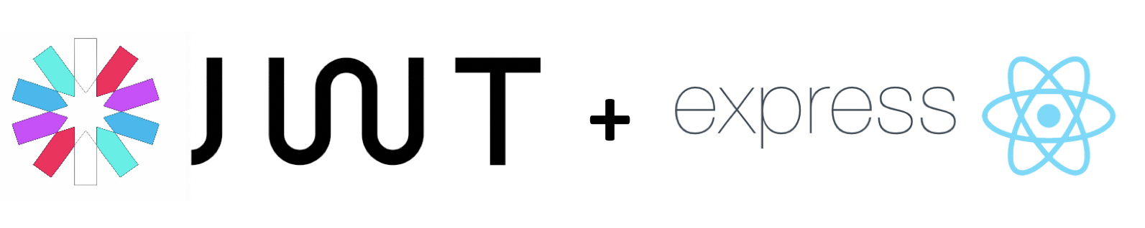
Back End
JWT
Express
Notes:
https://itnext.io/implementing-json-web-tokens-passport-js-in-a-javascript-application-with-react-b86b1f313436
uses JWT to verify the authenticity of a user. Express is used to build APIs

Slide 13

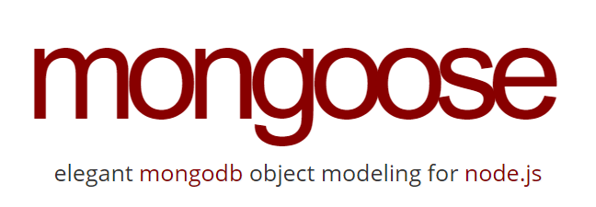
Database
NoSQL
MongoDB with mLab & mongoose
Pros:
Dynamic schema
Scalability
Manageability
Speed
Flexibility
Notes:
https://medium.com/xplenty-blog/the-sql-vs-nosql-difference-mysql-vs-mongodb-32c9980e67b2
use mLab to host MongoDB databases
Mongoose is a MongoDB object modeling tool designed to work in an asynchronous environment.
Dynamic schema: As mentioned, this gives you flexibility to change your data schema without modifying any of your existing data.
Scalability: MongoDB is horizontally scalable, which helps reduce the workload and scale your business with ease.
Manageability: The database doesn’t require a database administrator. Since it is fairly user-friendly in this way, it can be used by both developers and administrators.
Speed: It’s high-performing for simple queries.
Flexibility: You can add new columns or fields on MongoDB without affecting existing rows or application performance.

Slide 14
Database
Models
User
Candidate
Company
JC
Admin
Job
Feedback
CRUD system (no Delete function)

Slide 15
Remaining Work
Development
Admin Pages => Company list and Company details, Job List and Job Details
Client Pages => Edit Jobs
Candidate Pages => Home Page , Edit Candidate
JC Consulting =>Work Flow, Job Details, Edit Jobs/Allocate

Slide 16
Next Steps
Test all functionalities
integration with backend
Time for optimization

Slide 17
Thank You
Any questions?

